Slide 1

Data Story /Dashboard
By: Benjamin Phillippy

Slide 2
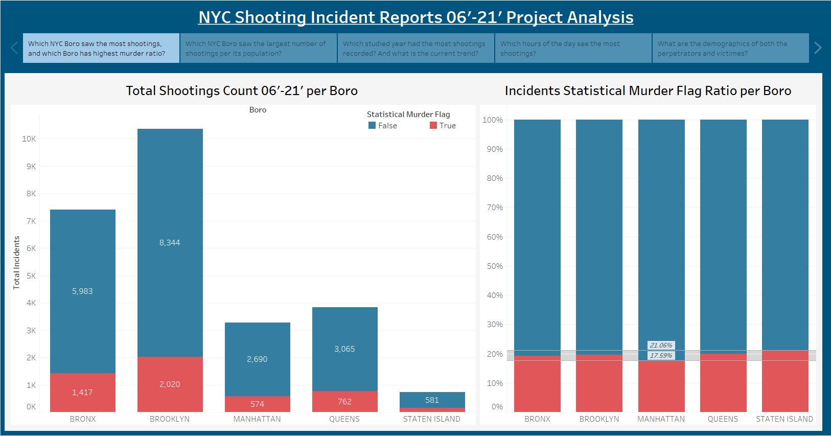

Slide 3
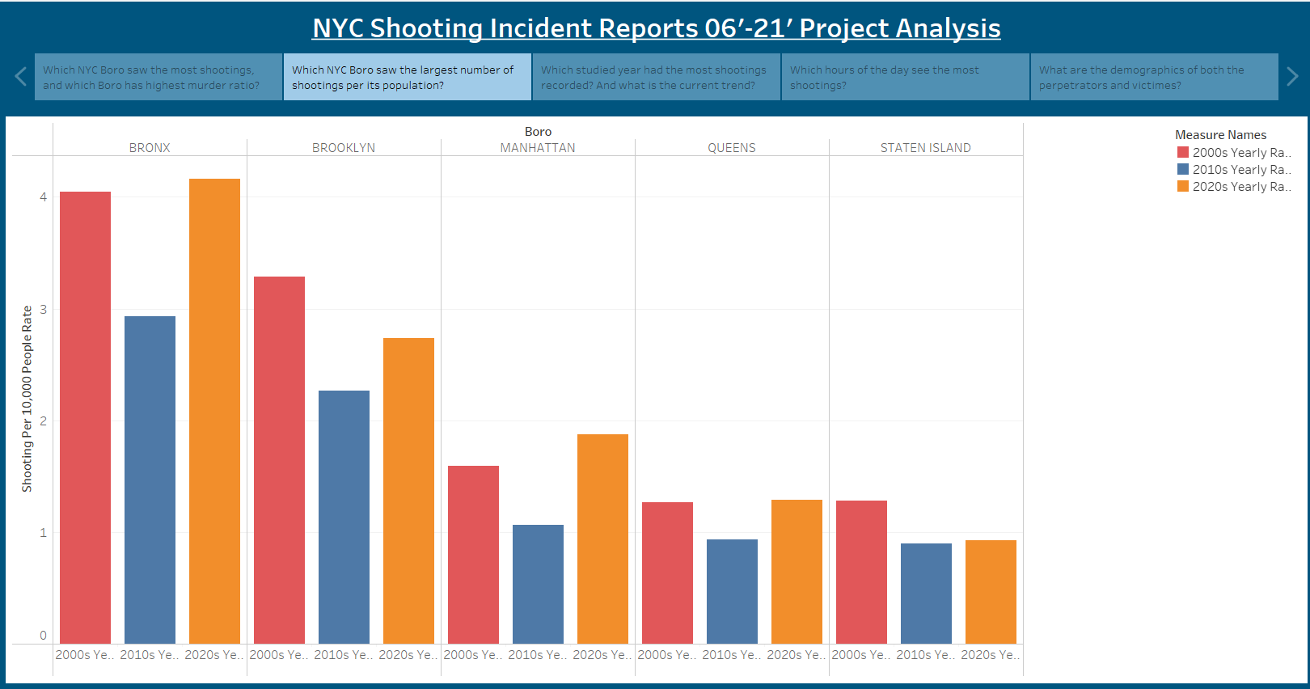

Slide 4
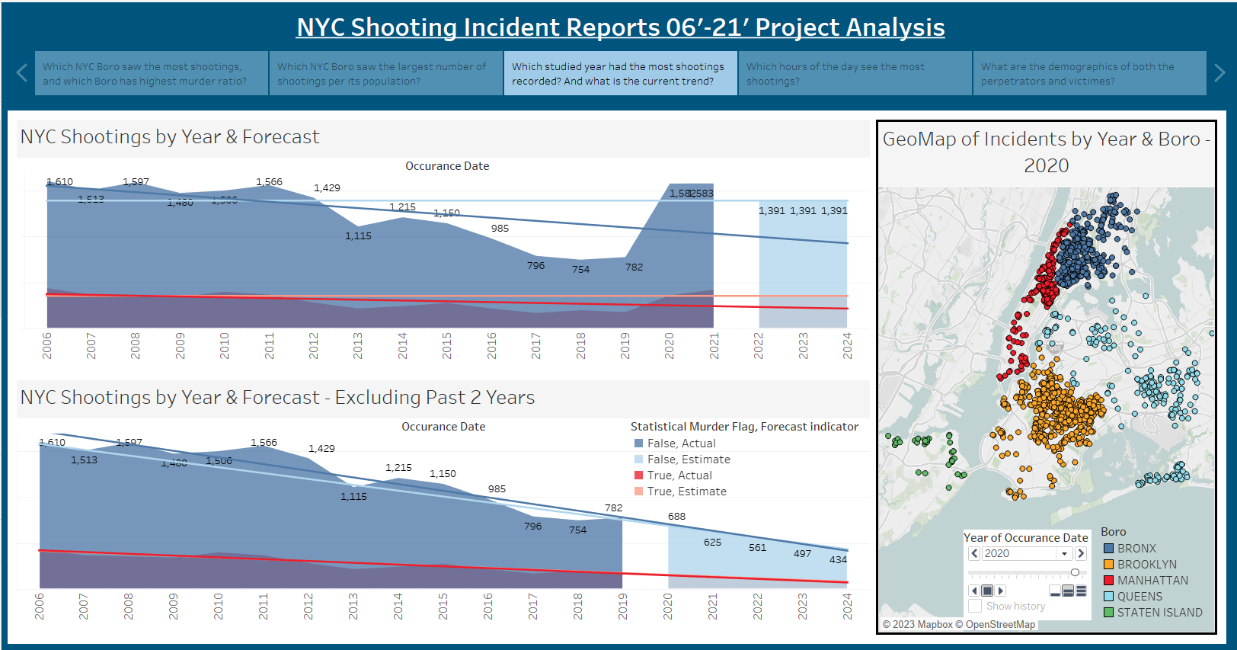

Slide 5
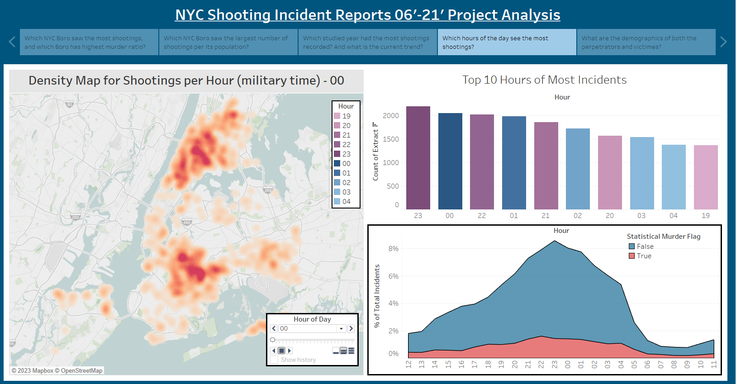

Slide 6
